Slide 1
Digital Circuits and Systems Lecture 12 Metastability and Synchronization Failure
Tian Sheuan Chang
(or When Good Flip-Flops go Bad)為什麼DFF會壞掉

Slide 2
Outline [Dally Ch. 27/28]
壞掉的DFF
當你違反setup time/hold time constraints時
對設計的影響與其解法
(何時最容易發生)

Slide 3
壞掉的DFF => 變成震盪器了 當你違反setup time/hold time constraints時

Slide 4
What happens when we violate setup and hold time constraints?

Slide 5
Look at structure of CMOS latch
Storage loop gets initialized with an ‘analog’ value
Latch is a “time-to-voltage” converter
Notes:
Clk = 0, =>clkbar = 1, D => V1, => V2 (setup time)
Clk = 1, clkbar =0, switch off, another switch on, V2=> V1, loop

Slide 6
Storage loop has a metastable state between 0 and 1

Slide 7
Dynamics of ΔV
Notes:
從藍線開始V1，輸出V2紅線,

Slide 8
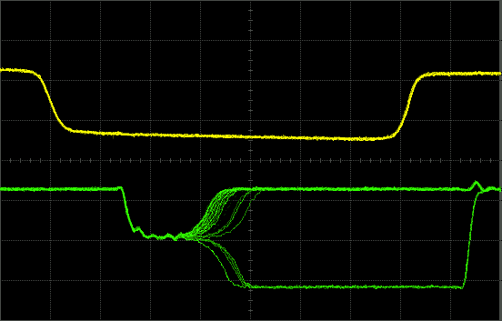
Metastable state of FF1 – 4007 Nand RS Latch

Slide 9
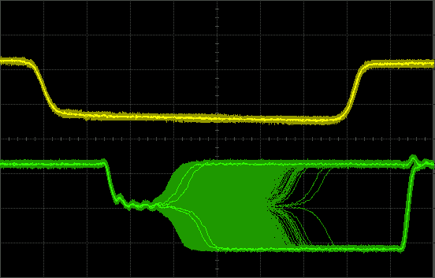
Over time the waveform fills in

Slide 10
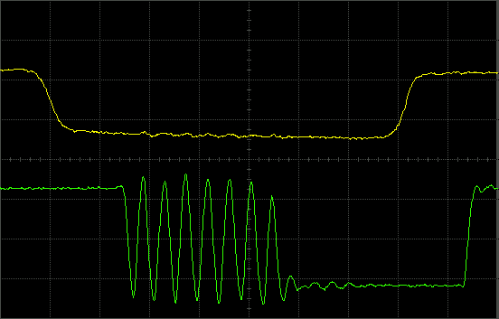
Metastable state of 4011 Nand RS Latch What’s going on here?

Slide 11
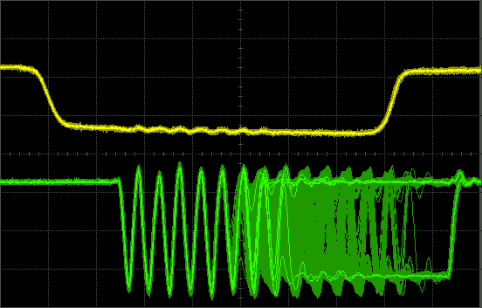
Over time this waveform fills in too

Slide 12
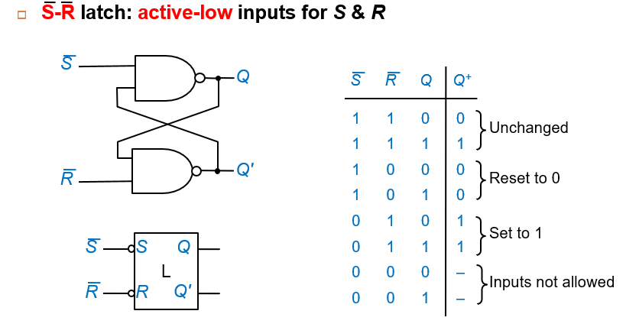
Actual circuit of 4011 Nand RS Latch

Slide 13
Initial state when both inputs are low
Notes:
0->1

Slide 14
When both inputs go high, it becomes a 6-stage ring oscillator Oscillation is metastable

Slide 15
Oscillation is metastable

Slide 16
If delays are balanced, ring sequences through six states repeatedly

Slide 17
對設計的影響 (何時最容易發生)

Slide 18
A Brute-Force Synchronizer

Slide 19
What if AW is still in a metastable state when FF2 is clocked?
訊號根本不穩定
會抓錯值

Slide 20
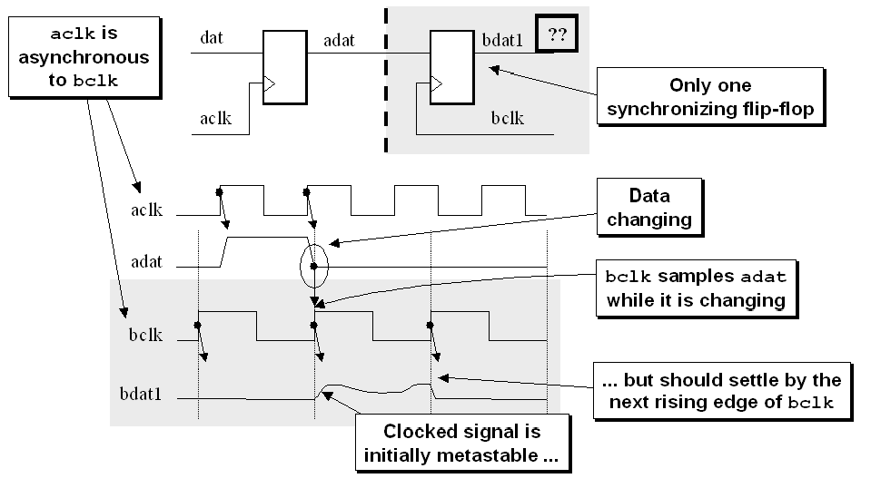
訊號跨越不同clock domain時，最容易發生
http://www.sunburst-design.com/papers/CummingsSNUG2008Boston_CDC.pdf
Notes:
http://www.sunburst-design.com/papers/CummingsSNUG2008Boston_CDC.pdf

Slide 21
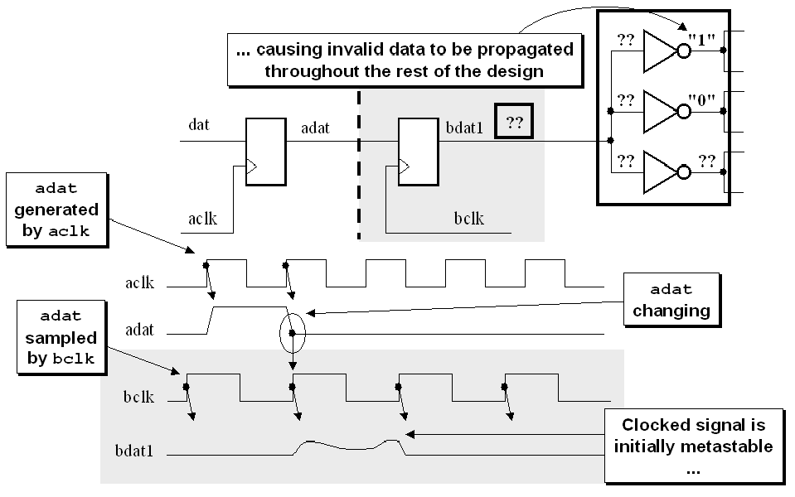
Metastable bdat1 output propagating invalid data throughout the design

Slide 22
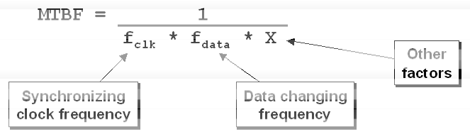
發生機率MTBF (mean time between failure)
failures occur more frequently (shorter MTBF) in higher speed designs, or when the sampled data changes more frequently.
越高頻或訊號變化越快，越容易產生錯誤

Slide 23
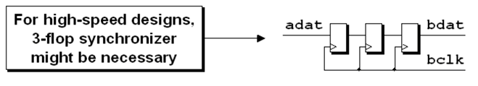
那設計要怎麼做?single bit case
超高頻設計，就用三個DFF串接

Slide 24
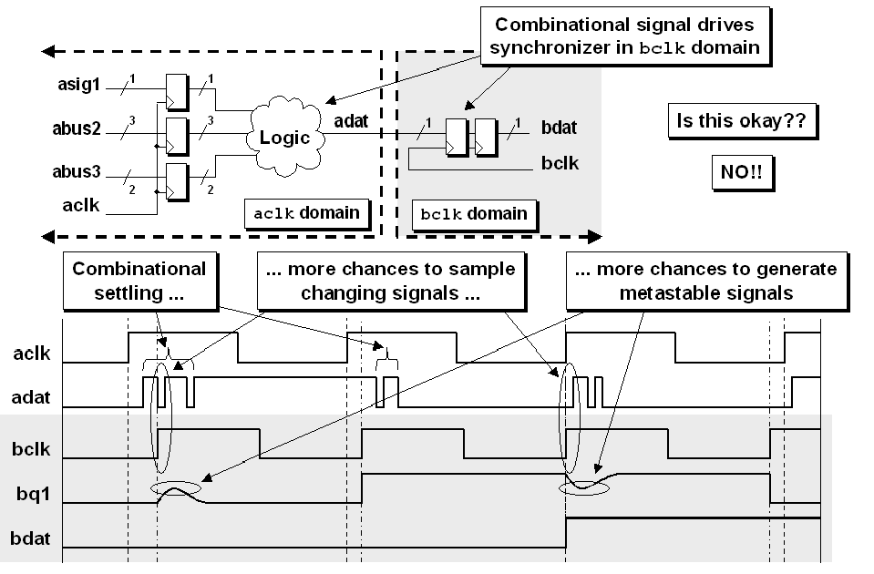
不良示範: 沒經過register就送過去
訊號亂動，抓錯機率高

Slide 25
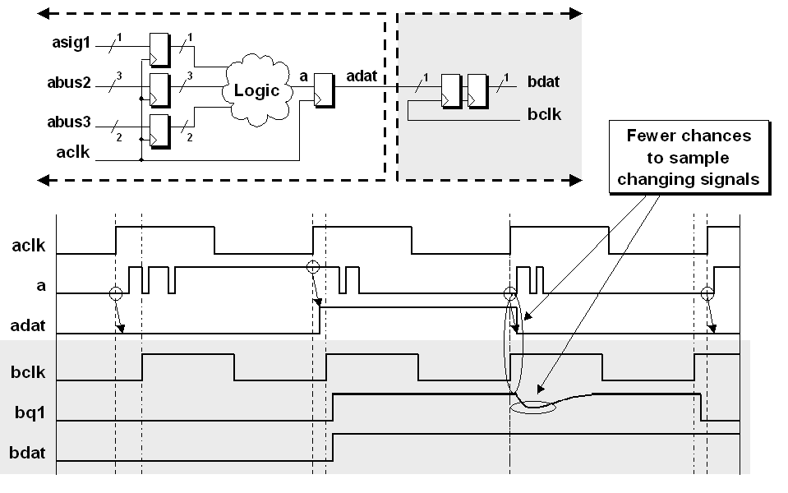
優良設計
發送端經DFF
接收端用兩顆串接
訊號較穩，抓錯機率小

Slide 26
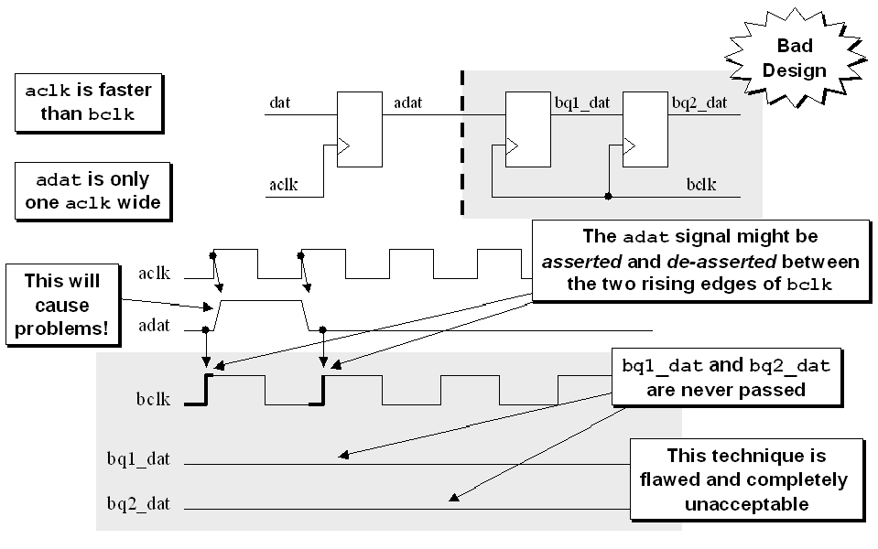
發送端訊號要怎麼給: 不能太短，會被錯過
adat length < bclk cycle

Slide 27
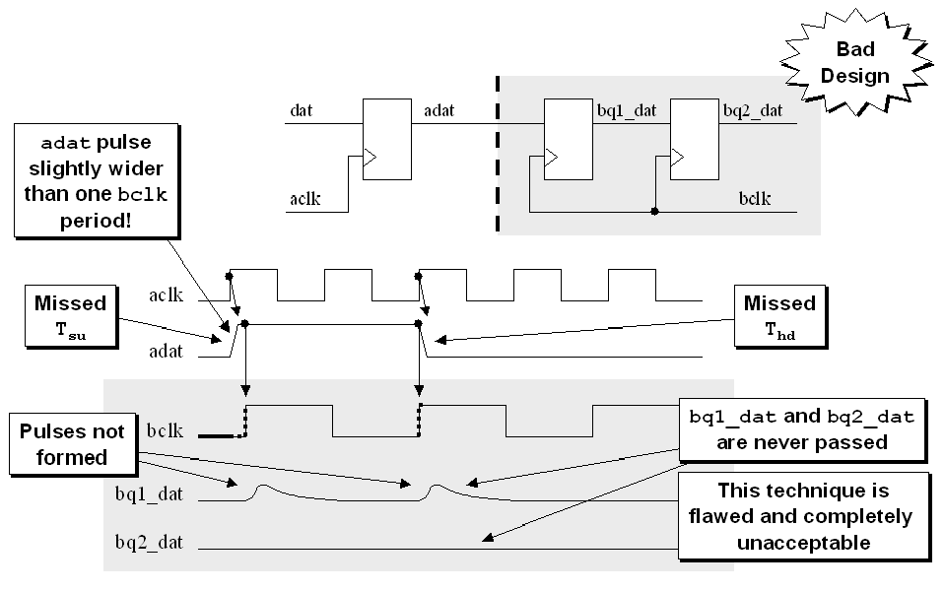
發送端訊號要怎麼給: 不夠長，也會被錯過
adat length slightly larger than bclk cycle

Slide 28
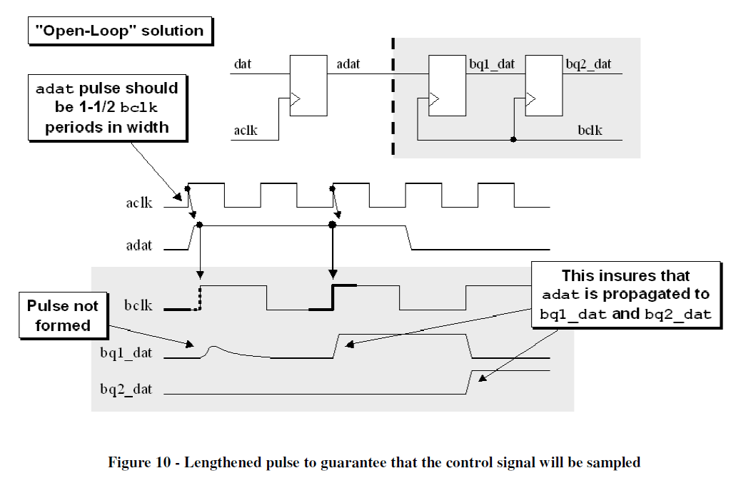
adat length >=1.5 bclk cycle
訊號要夠長，>=1.5X bclk

Slide 29
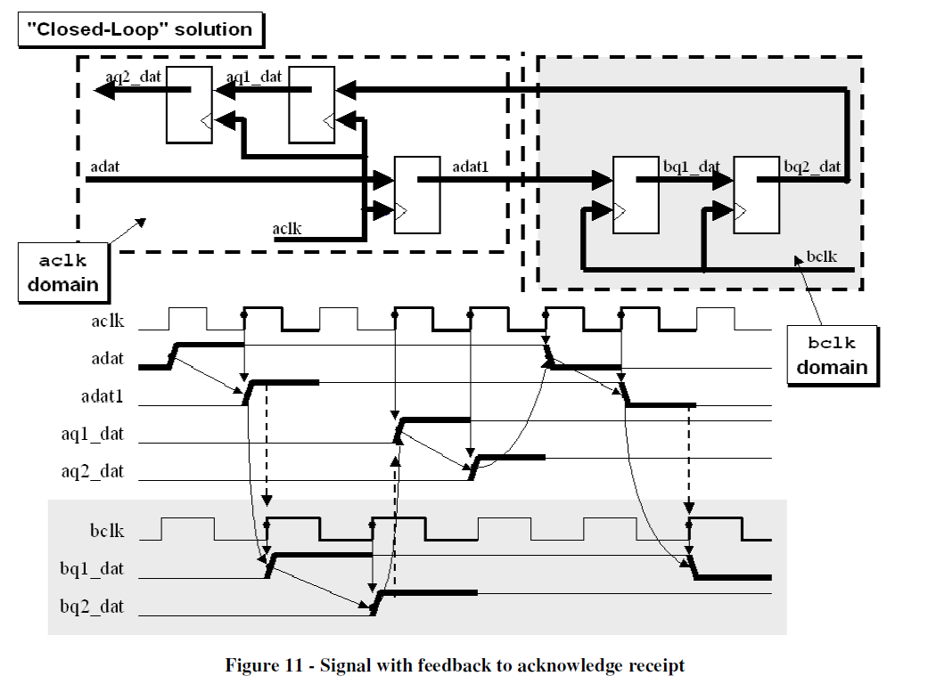
要寄有回條的掛號信
接收端回傳一個訊號，
告訴發送端已經收到，
發送端再關掉訊號

Slide 30
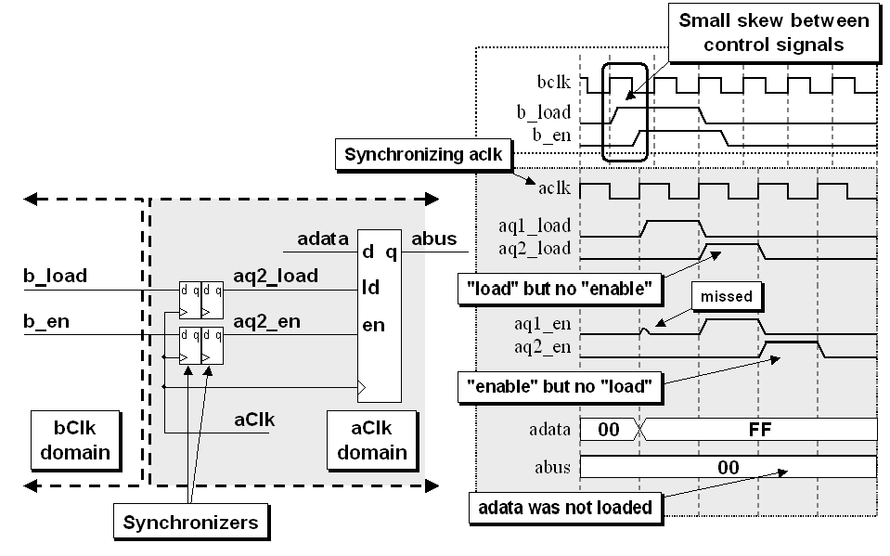
那設計要怎麼做?multi-bit case (control sig)
一次要對齊多個bit很難，容易錯位
個別傳過去
容易錯位

Slide 31
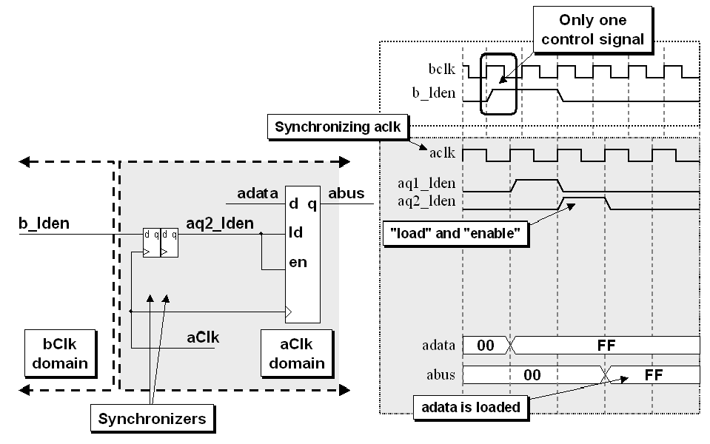
那設計要怎麼做?multi-bit case (control sig)
合併成單一控制訊號，比照單一bit去傳
合併成單一控制訊號

Slide 32
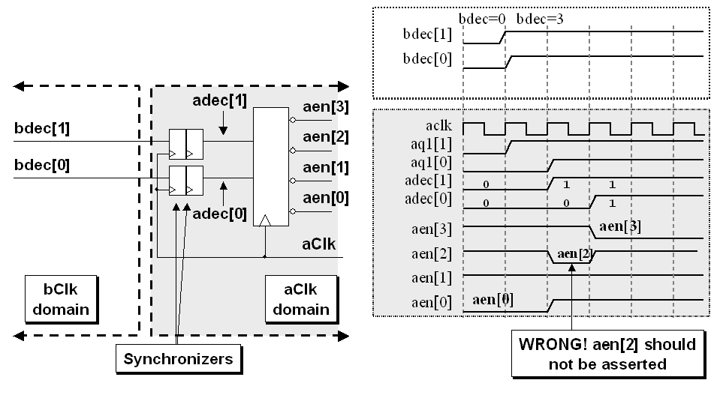
多個data bit 要傳，直接傳會出錯
One hot active low address decoder

Slide 33
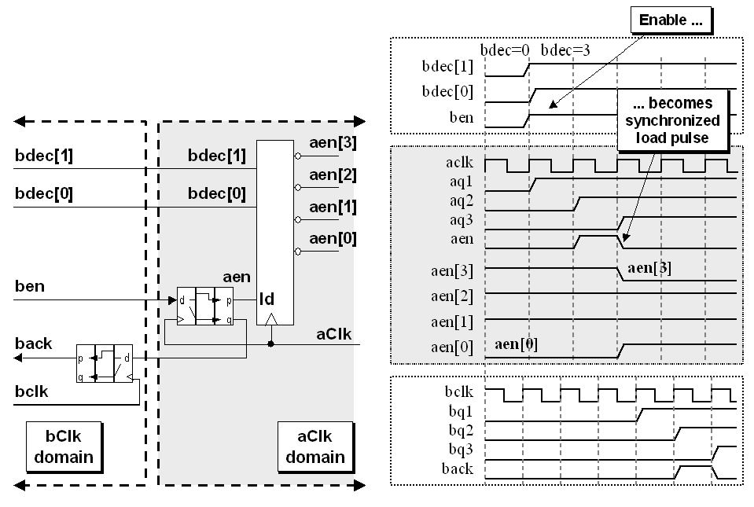
用單一控制訊號過同步器，再去控制data
One hot active low address decoder
單一控制訊號

Slide 34
Warning: The Surgeon General has determined that passing binary-coded and one-hot signals through a brute-force synchronizer can be hazardous to your circuits.
傳counter 值

Slide 35
Gray Code 是個好主意，一次只有一個bit變
Solution:
Use a Gray code counter
For all but the MSB:
next_b[i] = (b[i-1] & !(|b[i-2:0])) ? !xor(b[n-1:i+1]) : b[i];
For the MSB:
next_b[i] = (|b[i-2:0]) ? b[i] : b[i-1] ;
Can we use this Gray code for the head and tail pointers of our FIFO?

Slide 36
module GrayCount4(clk, rst, out) ;
input clk, rst ;
output [3:0] out ;
wire [3:0] out, next ;
DFF #(4) count(clk, next, out) ;
assign next[0] = !rst & !(out[1]^out[2]^out[3]) ;
assign next[1] = !rst & (out[0] ? !(out[2]^out[3]) : out[1]) ;
assign next[2] = !rst & ((out[1] & !out[0]) ? !out[3] : out[2]) ;
assign next[3] = !rst & (!(|out[1:0]) ? out[2] : out[3]) ;
endmodule

Slide 37
module gray2bin #(parameter SIZE = 4)
(output logic [SIZE-1:0] bin,
input logic [SIZE-1:0] gray);
always_comb
for (int i=0; i<SIZE; i++) bin[i] = ^(gray>>i);
endmodule
module bin2gray #(parameter SIZE = 4)
(output logic [SIZE-1:0] gray,
input logic [SIZE-1:0] bin);
assign gray = (bin>>1) ^ bin;
endmodule

Slide 38
# xxxx
# 0000
# 0001
# 0011
# 0010
# 0110
# 0111
# 0101
# 0100
# 1100
# 1101
# 1111
# 1110
# 1010
# 1011
# 1001
# 1000
# 0000
# 0001
# 0011
# 0010

